Slide 1

Project 3: Web APIs & Classification

Slide 2




Slide 3
Problem Statement
To create a classification algorithm that would automatically classify posts by anyone to relevant sub-reddit based on content of posts and hashtags mentioned by author

Slide 4
Data Extraction
Webscrapping from json
EDA and data cleaning
Duplicate data removed
Modelling
Logistic regression with Count Vectorisation
Lemmatising/ Stemming
Train - test
Logistic regression with TFIDF Vectorisation
Multinomial Naïve Bayes with Count Vectorisation
Binomial Naïve Bayes with TFIDF Vectorisation
Evaluation
Confusion matrix

Slide 5

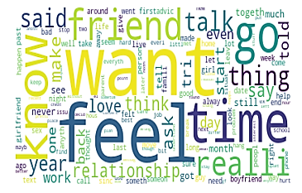
Word Cloud
Legal advice
Relationship advice

Slide 6
Models
Models | Accuracy score
Logistic regression with Count Vectorisation | 98%
Logistic regression with TFIDF Vectorisation | 97.1%
Multinomial Naïve Bayes with Count Vectorisation | 97.5%
Binomial Naïve Bayes with TFIDF Vectorisation | 87.5%
Gridsearch of hyperparameters carried out for Count Vectorisation and TFIDF Vectorisation

Slide 7

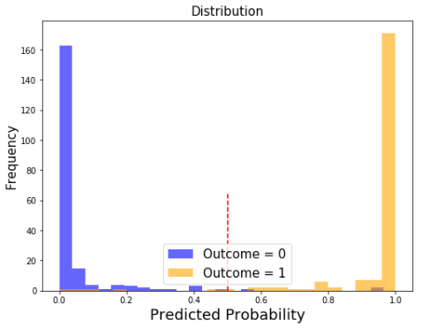
Best Model
Logististic Regression with Count Vectorisation
Accuracy: 97.8%
Sensitivity: 97.1%
Specificity: 98.5%
Precision: 98.5%

Slide 8
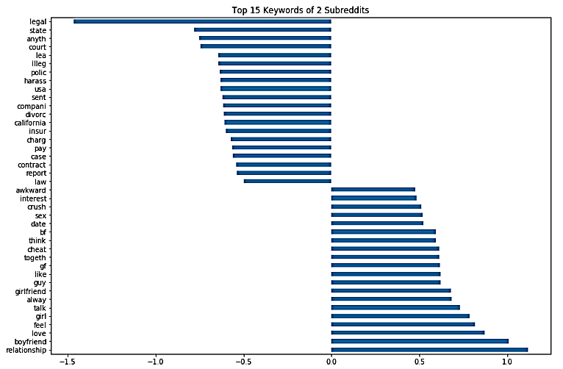
These are the top 15 words from each subreddit used to classify posts

